Slide 1
Goose Chaperone
Team: SDDEC19-17
Weston Berg | Zhihao Cao | Alec Morris | Johnson Phan | Woodrow Scott
Notes:
Zhihao Cao

Slide 2
Project Design

Slide 3
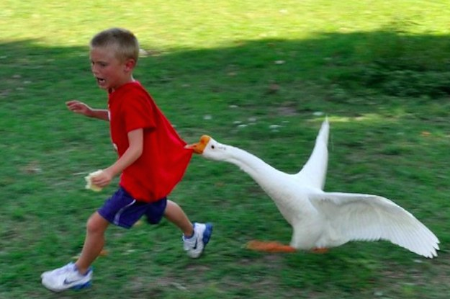
Introduction
Problem Statement
Canadian geese nesting on private property
Destroying property, harming humans
Our Tasks
Build autonomous robot
Oust geese from selected area
https://www.buzzfeed.com/sarahaspler/you-win-some-you-goose-some
Notes:
Zhihao Cao

Slide 4
Requirements
Functional
Robot must have sensor(s) capable of recognizing geese
Robot must be able to aggregate data from multiple sensors and act accordingly
Robot must be capable of movement via motorized wheels
Non-Functional
Software implementation platform-independent and scalable where possible
Abide by relevant laws
Constraints
Total cost of robot may not exceed $400
Notes:
Alec

Slide 5
Similar Products
Goose Guardian
Equipped with camera for goose recognition but does not move
SMP Bird Control Robots
Very similar in functionality and design
Different models come with different deterences
Notes:
Woodrow Scott

Slide 6
System Components
Notes:
Johnson

Slide 7
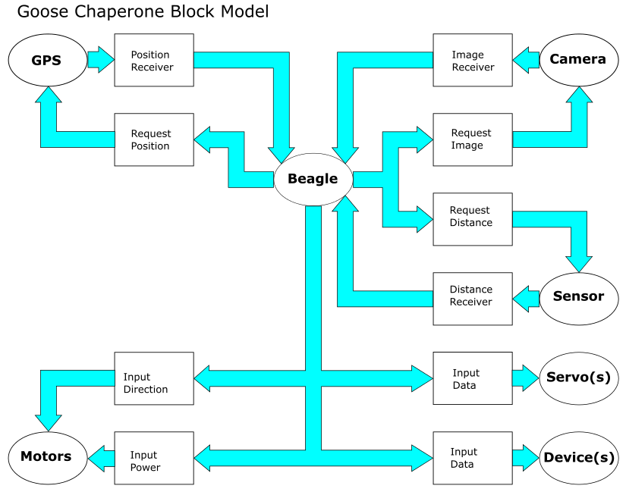
Logical Relationships
Notes:
Johnson
This diagram contains the relationships between components. The servos and motors take inputs from the beaglebone to move while the beaglebone takes inputs from the gps, camera, and sensor to make judgements.

Slide 8
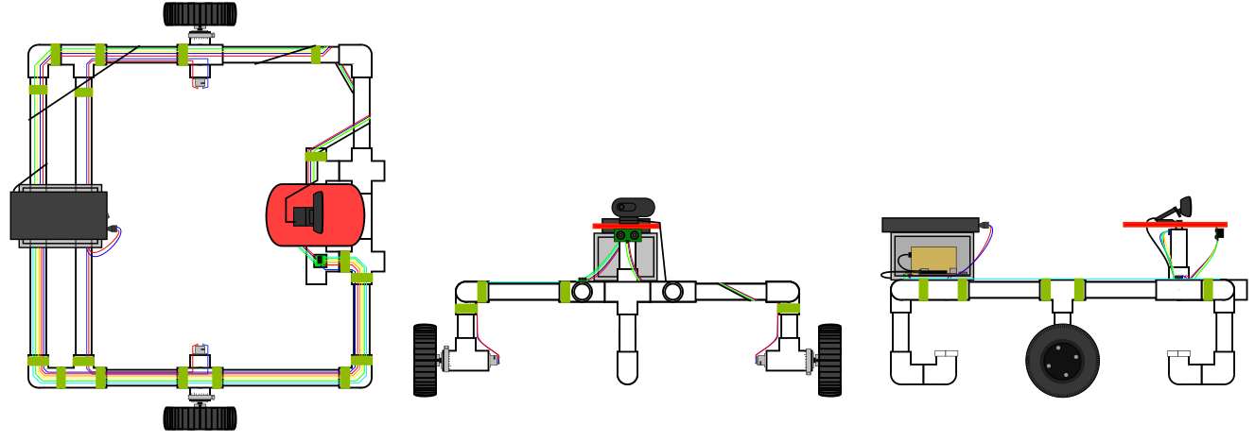
Structural Integrity
Summary
PVC 1” solid core
Platform for
Stepper Motor
Camera
Sensor
Batteries and Controller
Left and Right Wheels
Elbow PVCs Balancer
Function
Durable/Resistant
Front View
Fewer Back Attack
Almost Perfect Rotations
Balance and Lesser Friction
Issues
Exposed Wires
Weak connectivity weaken certain components
Notes:
Johnson Phan
The model is build out of 1” solid core PVC. Platform to the upper front to hold camera and sensor held by stepper motor. Batteries and controller to the upper back. Wheels to the lower left and right. And PVC elbows to the lower front and back. The PVC makes it durable and resistant to environment erosions. Upper front for the least restricted view with camera on top of platform with sensor below the platform. Upper back to balance the front and not hinder the front operations. Lower left and right of using two wheels for almost perfect rotations. Finally lower front and back PVCs for balance and due to the nature of PVC, less friction on movement. Issues are that the prototype wiring are exposed to the environment.

Slide 9
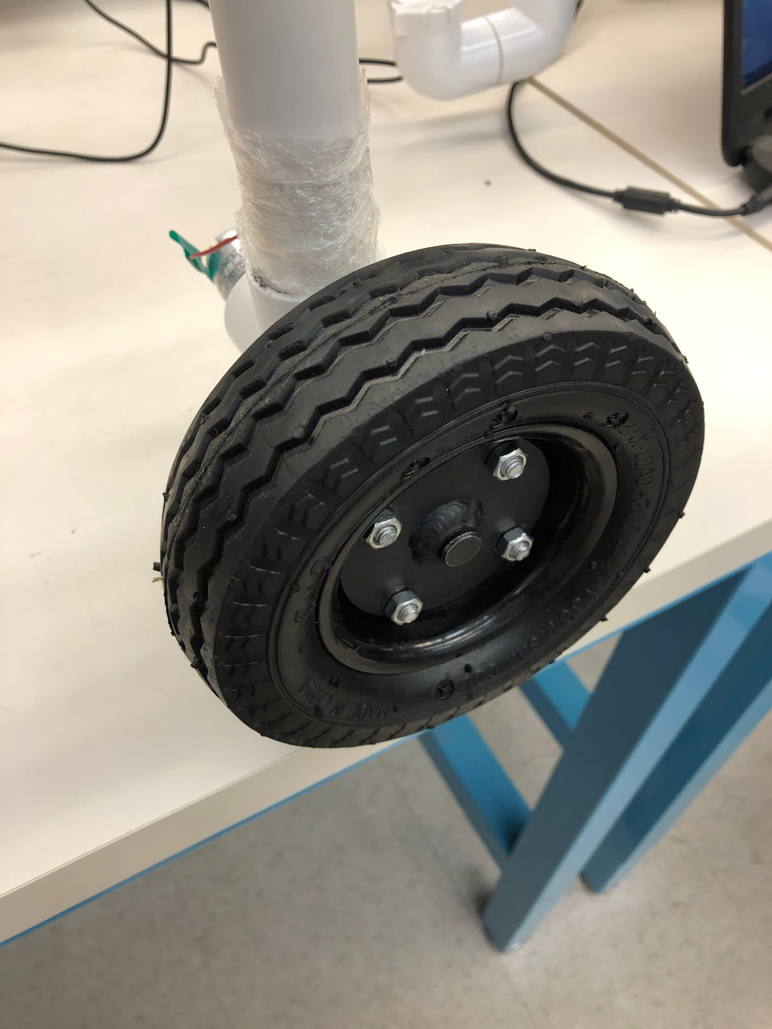
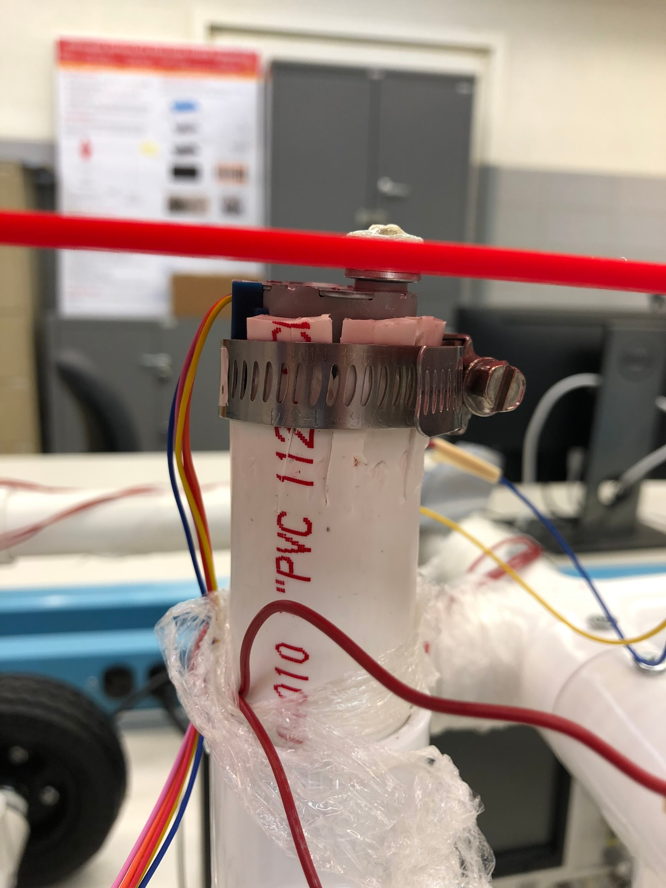
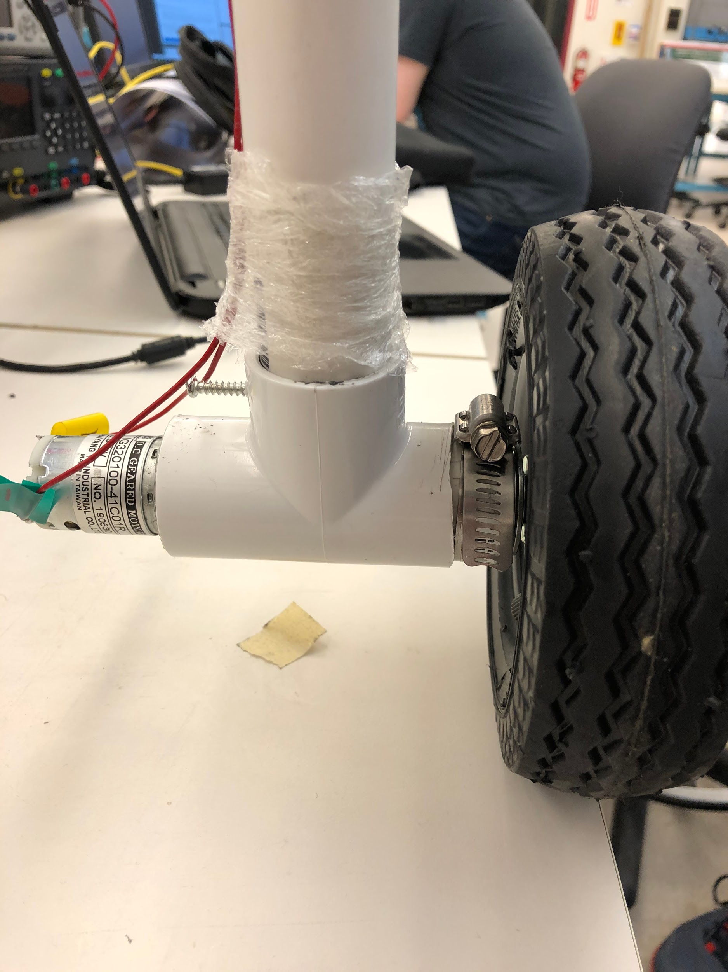
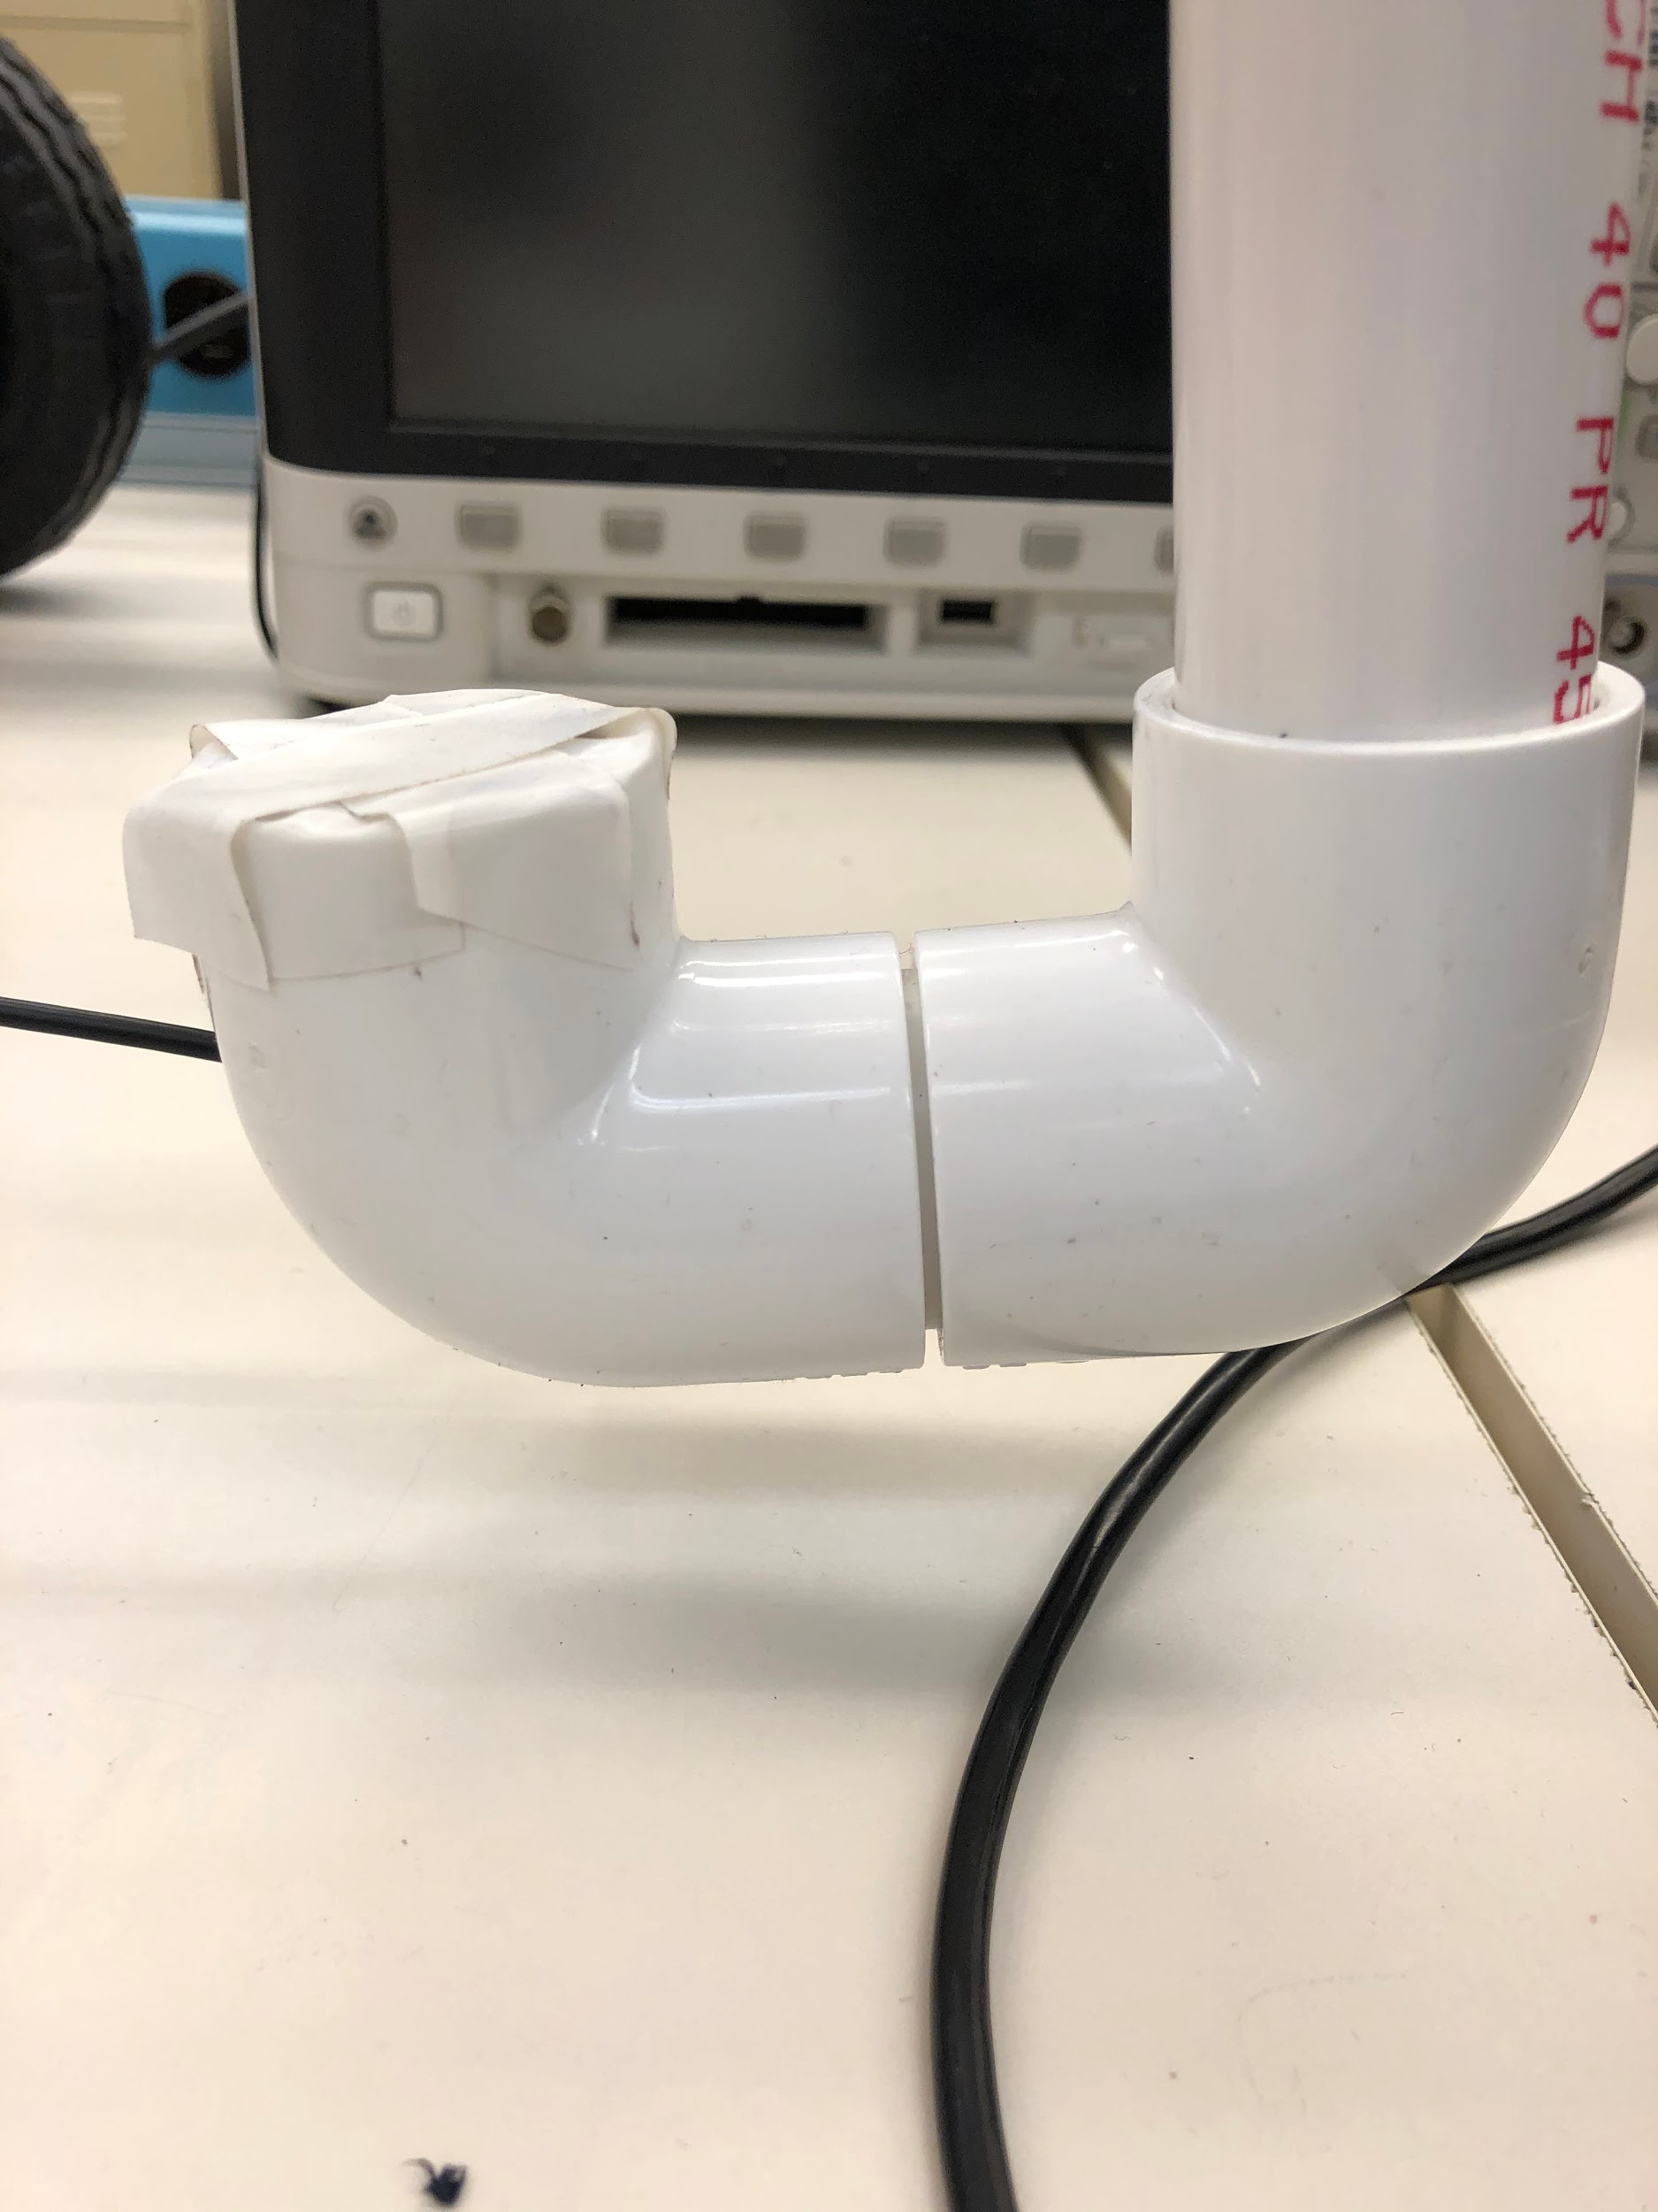
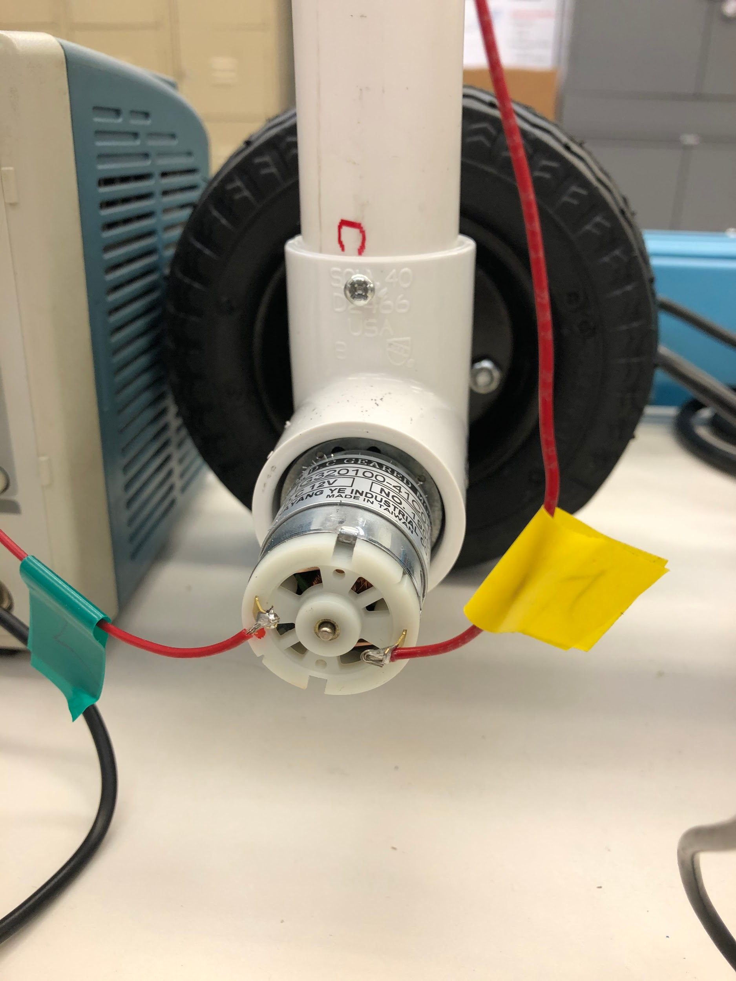
Movement System
Summary
Single 5V Stepper Motor
Hold Vision Platform
Two 12V Brushed Motors
Wheel Operations
12.6V/3A Power Source
Function
Swivel camera, distance sensor left and right
Allow robot forward, reverse, and turning movement
Issues
Brushed motors work, yet it cannot move model
Improper physical or electrical connection, motors too weak, faulty PWM chips
Notes:
Weston Berg

Slide 10
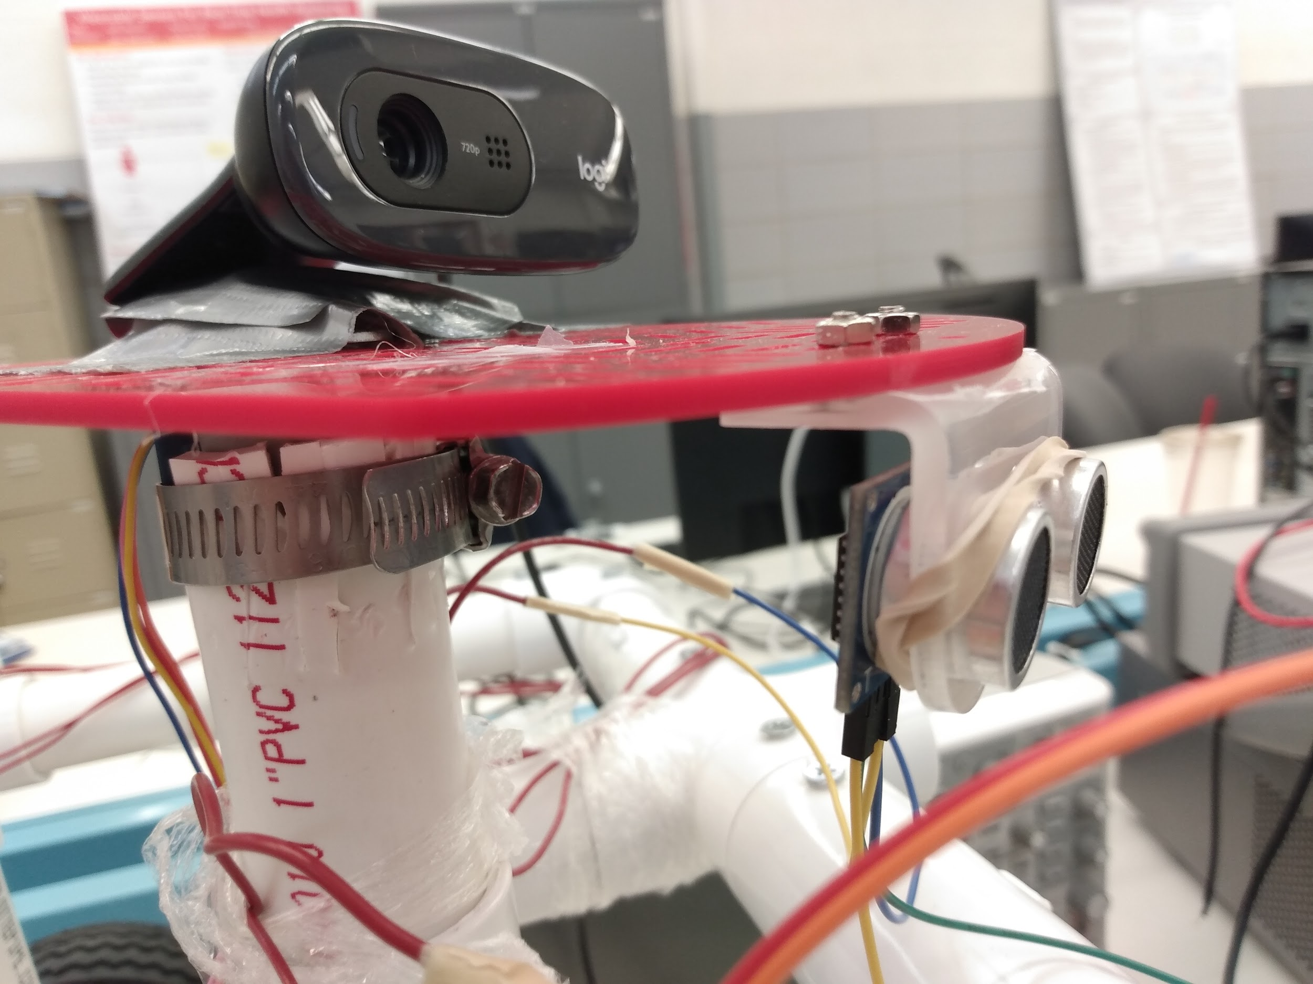
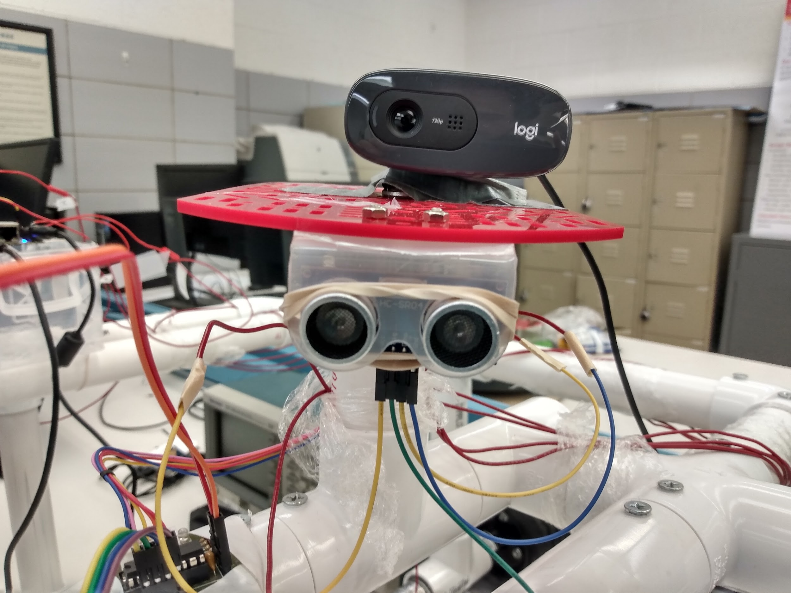
Distance Detection
Summary
Ultrasonic distance sensor
Object and distance detection
Beaglebone as power source
Function
Warn bot’s mainloop when approaching objects
Allow bot to move to a specified distance away from an object
Issues
None
Notes:
Zhihao cao

Slide 11
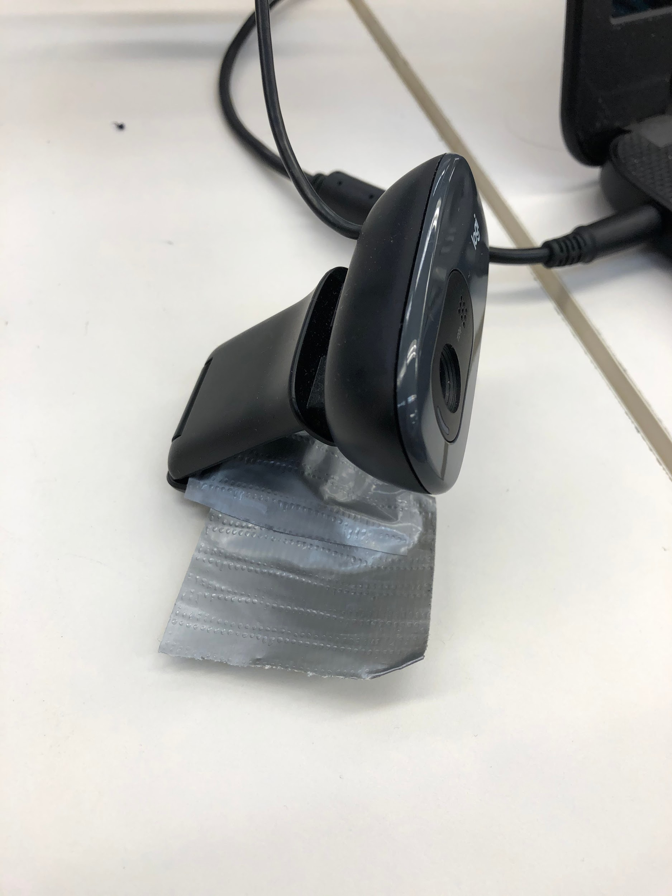
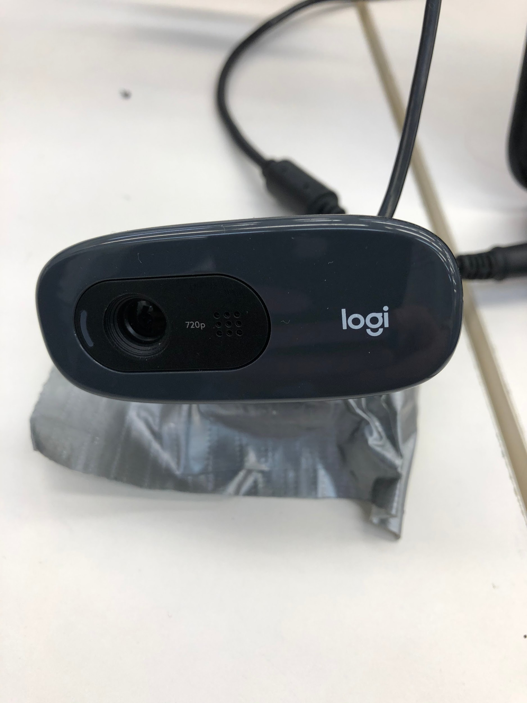
Vision System
Summary
Logitech Camera
Tensorflow and OpenCV
Tensorflow identifies targets
OpenCV controls camera and visualizes detections during testing
Swiveled by stepper motor
Captures and analyzes around 10 images per second
Function
Primary: Geese detection
Secondary: People detection
Rotation for wider coverage
Provide detection results for bot logic
Issues
Currently only supports goose and human detection in code, does not reliably detect sand traps and water hazards
Notes:
Woodrow Scott

Slide 12
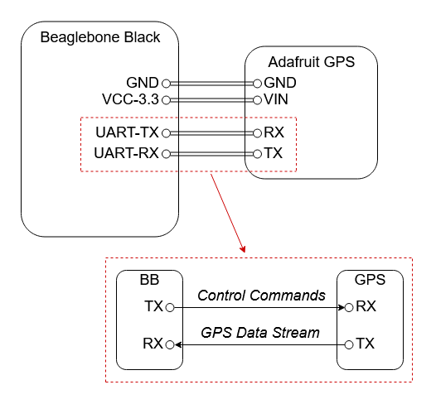
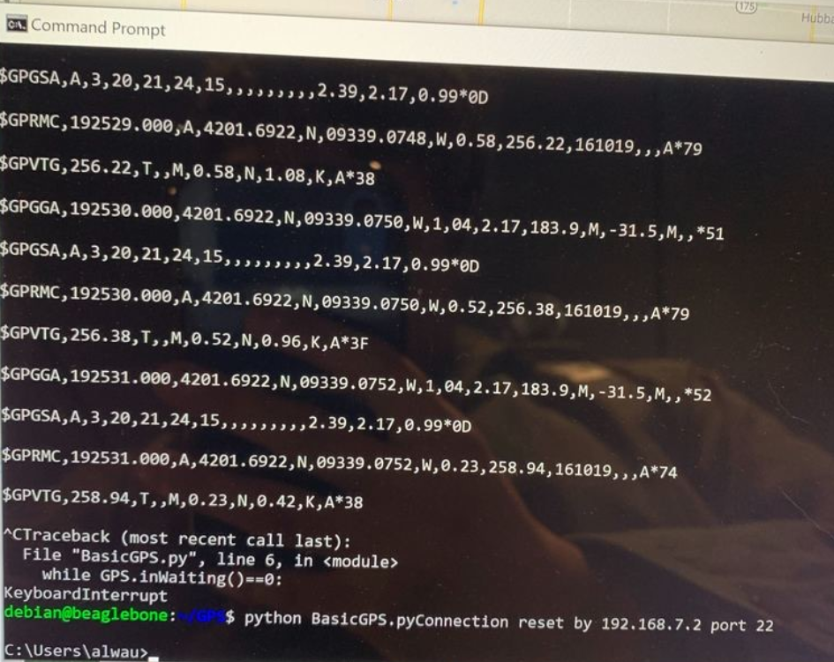
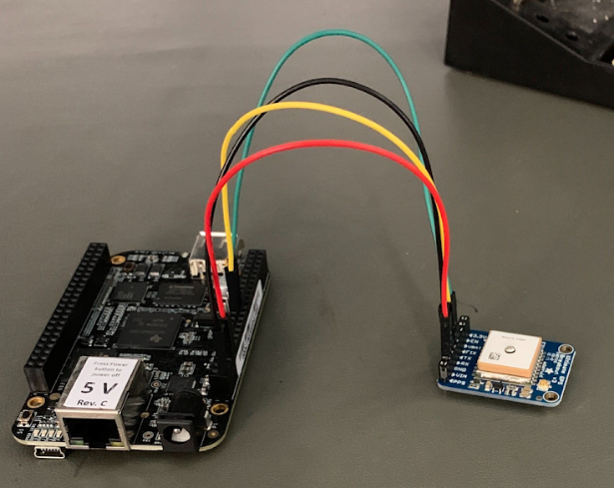
Navigational System
GPS Module- Adafruit Breakout GPS
Low power, 10 HZ updates.
Python Script
Gets raw data from GPS module
Data is sent through UART on Beaglebone
Data is then parsed for use in program
Issues
GPS can only get a fix outside
Insufficient time to combine with main program
Above Right: Diagram of GPS connection to board.
Right: Raw data from GPS before it’s parsed for relevance.
Left: Photo of GPS Module connection.
Notes:
Alec Morris

Slide 13
Software

Slide 14
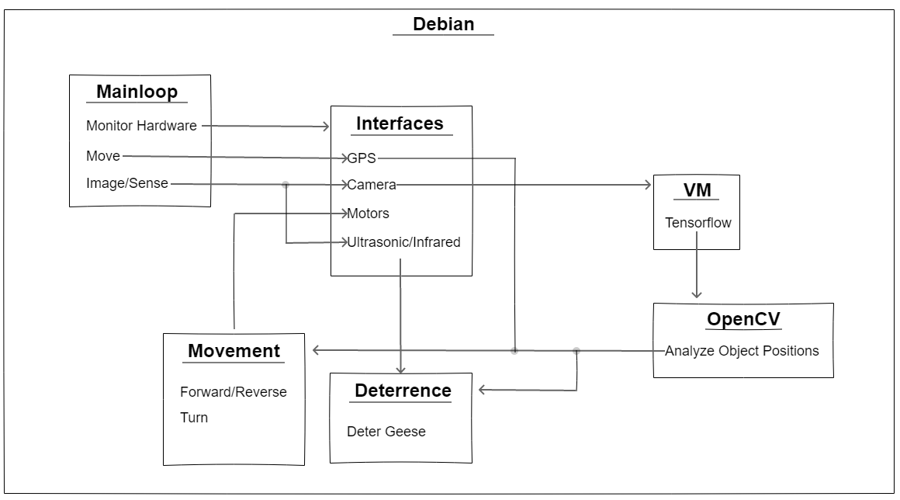
Software Relationships
Notes:
Wes

Slide 15
Driver Implementation
Adafruit_BBIO
Preferred over native Bonescript + Node.js
Exposes GPIO, PWM, UART, etc. to Python
Design Patterns
Singleton
Object-oriented
Decoupled Configurations
Initializes functions
Notes:
Wes

Slide 16
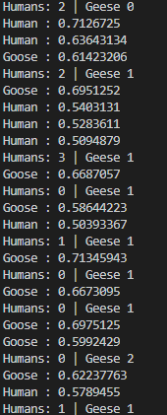
Tensorflow
Developed by Google Brain Team
Used for creating and executing deep neural networks
Image Processing
Easiest method is to use existing trained model
Different architectures provide different costs and benefeits
We used SSD_MobilenetV1 originally trained on the COCO set
Models retrained via feeding large tagged image sets and undergoing regression training
Notes:
Woodrow Scott

Slide 17
Bot’s Mainloop Logic
Detection
Shrink and feed image through tensorflow
Filter results to return detection classes of humans and geese
Data contains confidence percentage of detections and bounding box coordinates
Roaming
Scan each direction via swivelling the stepper motor
If target found, charge towards target
Otherwise, continue along route
Notes:
Woodrow Scott

Slide 18
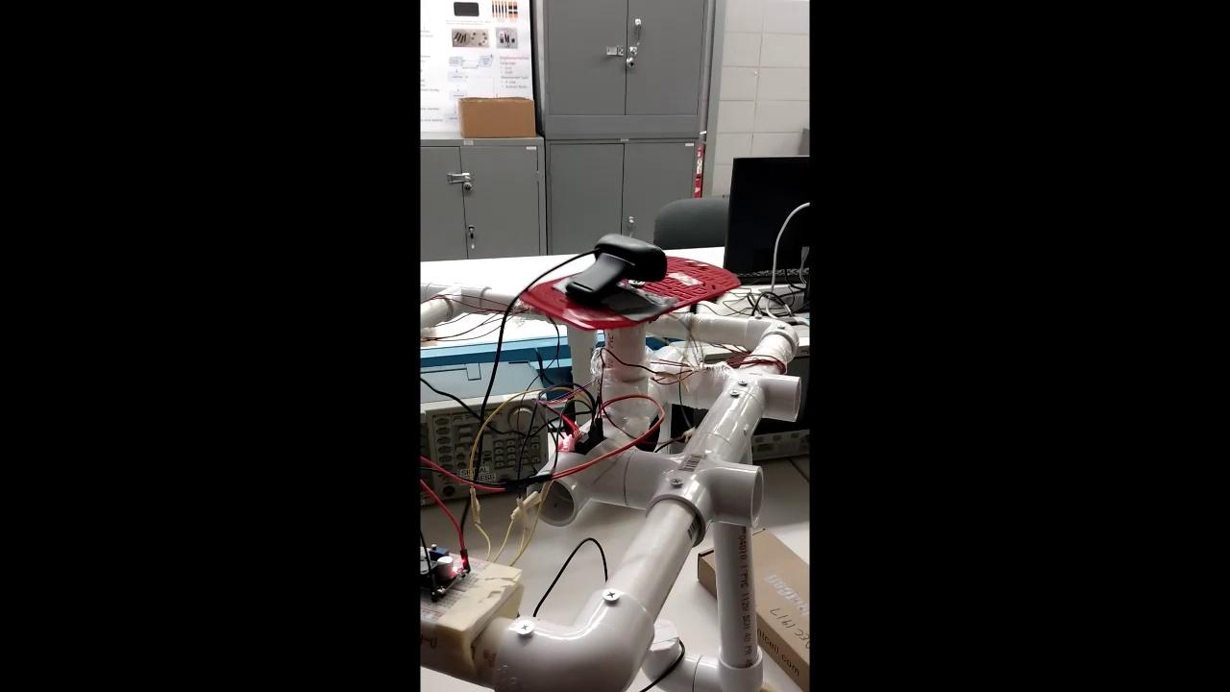
Demo

Slide 19
Conclusion
Project Successes
Successful component testing with proper compatibility to Beaglebone
Created working Tensorflow model that can classify geese and humans
Built usable chassis from scratch
Knowledge gained on previously unexplored topics
Laid groundwork if project picked up by senior design group in the future
Project Issue and Challenges
Desire to find “perfect” solution led to short-sightedness on ease of development
Long planning period reduced overall development and testing time
Late assembly did not allow enough time to diagnose and fix motor problem
Single microcontroller slowed development
Notes:
Johnson Phan
Our project did have its successes. The project’s model is made from scratch. We properly tested each individual components and they work with the Beaglebone. One of the main functions, the Tensorflow, has been filtered to identify geese and people. We have learned from topics we never touched on before and laid the groundwork for future senior design group to pick up. The issues our group faced were that we took too much time researching for the best solution and long period of planning reduced our overall development. That led to the late assembly which did not give us enough time to diagnose and fix motor problems. On the software side, having a single microcontroller which prevent us from developing and testing codes individually.

Slide 20
Question?

